Slide 1
Genetic description of oncogenic KRAS mutations
Joshua Cook & Giorgio Melloni
Haigis & Park labs
October 22, 2019
SpecifiCancer

Slide 2
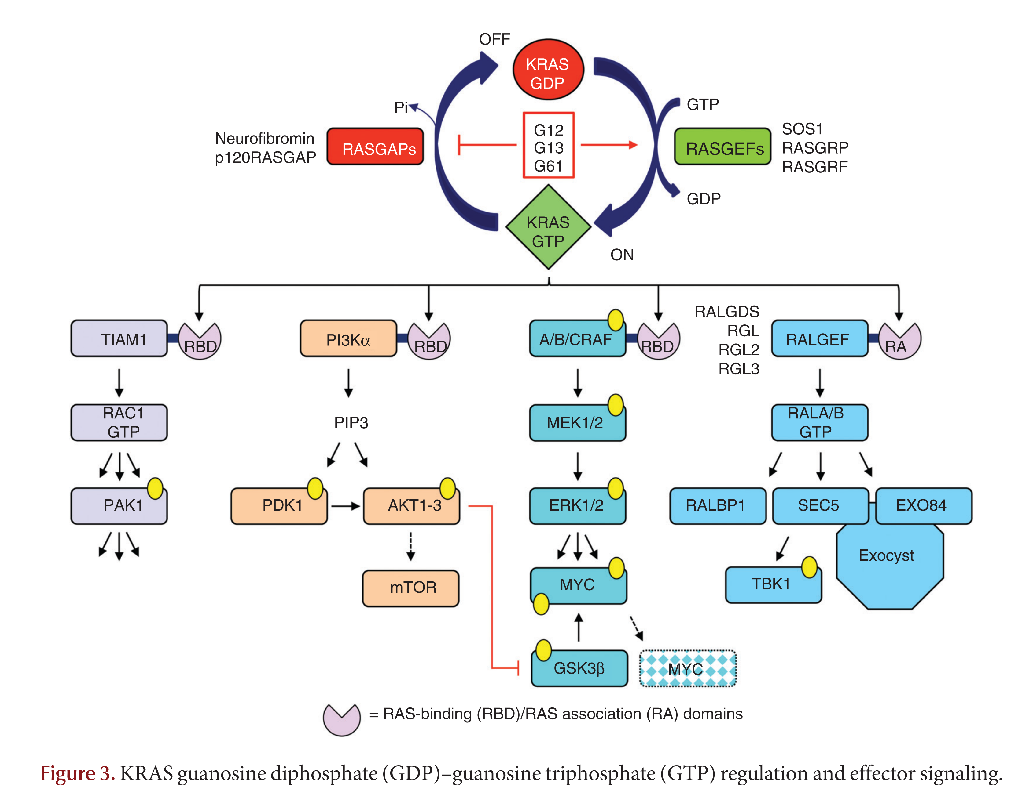
KRAS is a GTP-regulated switch
Waters & Der, 2018

Slide 3
KRAS regulates many pro-growth processes
Cytoskeletal reorganization
cell motility
PI3K-Akt
MAPK
Waters & Der, 2018

Slide 4
KRAS is mutated very frequently in a handful of cancers
TCGA data on cBioPortal

Slide 5
The KRAS mutations are different across cancers
COAD
LUAD
MM
PAAD
frequency (%)

Slide 6
Can we explain the frequency of KRAS alleles
by mutational processes?

Slide 7
The alleles are associated with similar mutational processes
COAD
LUAD
clock
smoke
clock
MUTYH
MM
PAAD
clock
Pol η
Notes:
Signatures:
Clock
APOBEC dysfunction
HR-defect
Smoke
Clock
8. unknown
9. Pol eta defects
13. APOBEC dysfunction
17. unknown
18. MUTYH defect
30. BER due to inactive NTHL1
N3v2. ?
Biallelic MUTYH mutations impair this enzymatic function and are associated with colorectal cancer (CRC) in MUTYH-Associated Polyposis (MAP) syndrome.
An endogenous mutational process initiated by spontaneous or enzymatic deamination of 5-methylcytosine to thymine which generates G:T mismatches in double stranded DNA. Failure to detect and remove these mismatches prior to DNA replication results in fixation of the T substitution for C.

Slide 8
The mutational processes, alone, do not predict the alleles
COAD
LUAD
Predicted
MM
PAAD
Observed

Slide 9
Can we identify genetic interactions
with the KRAS alleles?

Slide 10
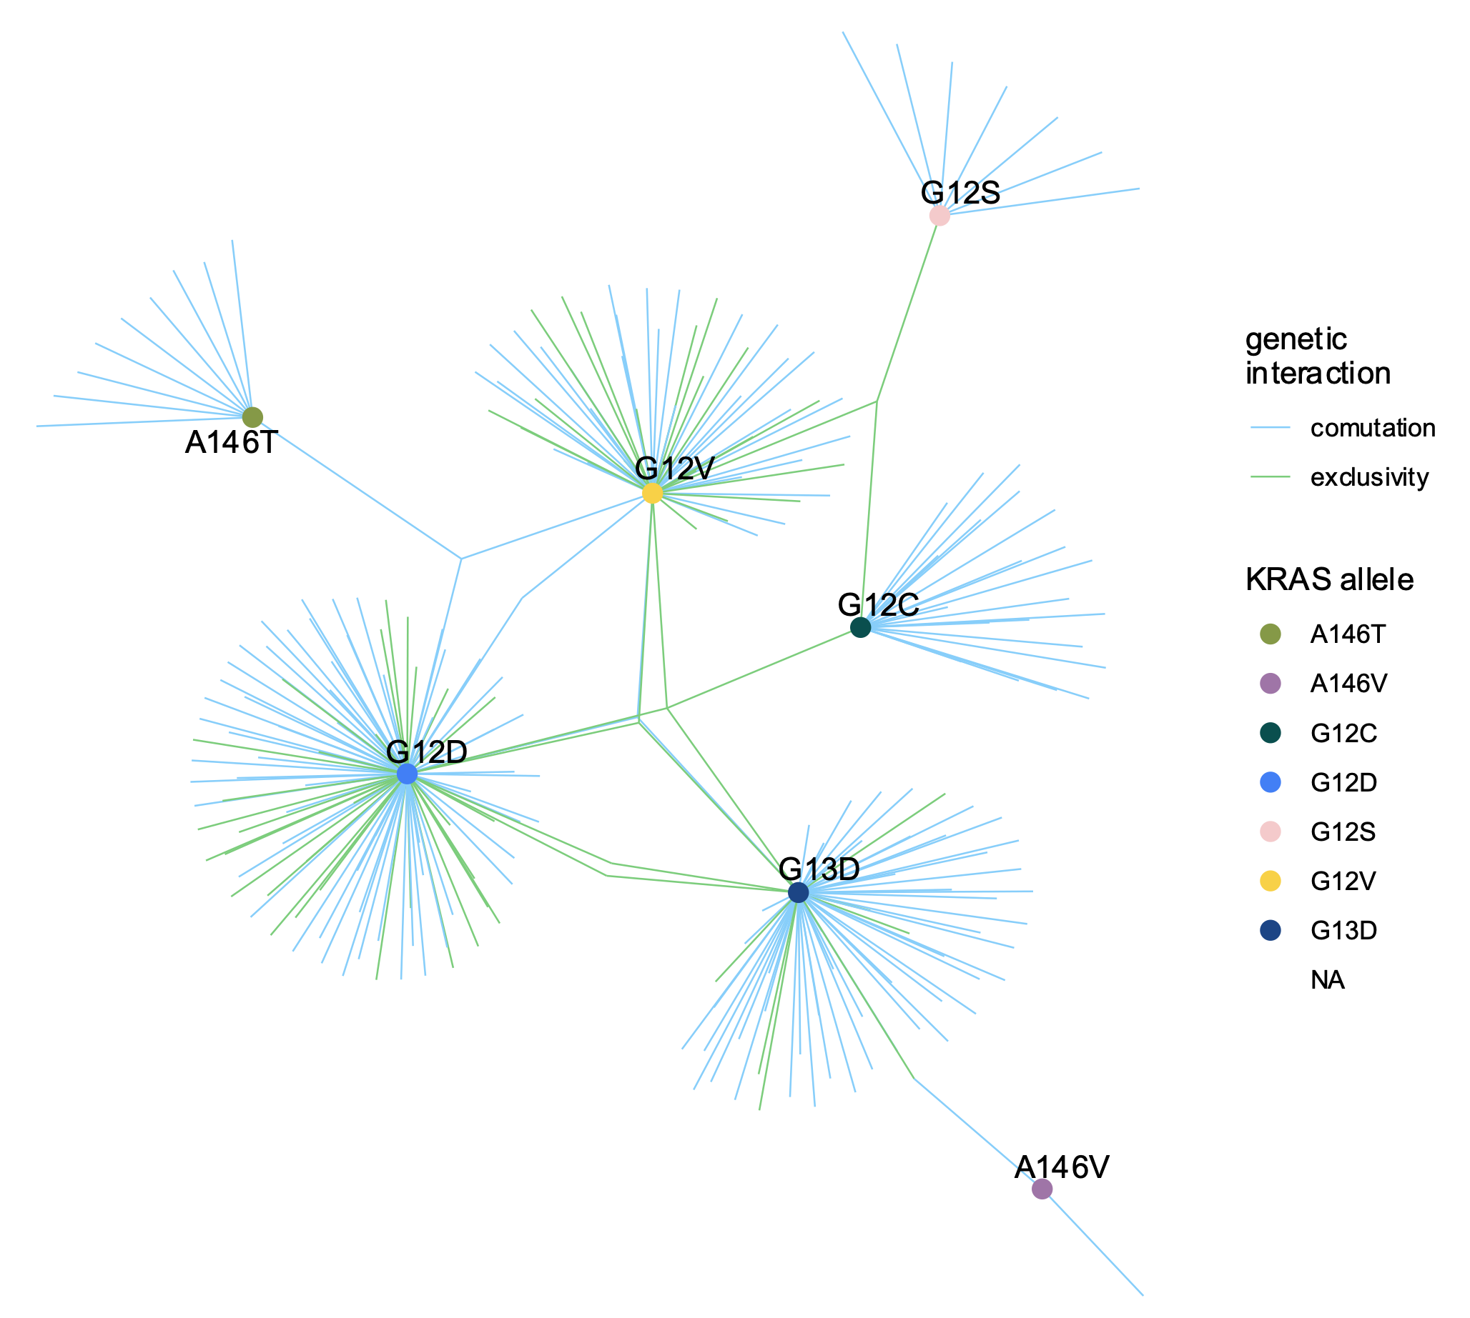
The KRAS alleles have distinct comutation interactions
COAD
Notes:
Thicker lines
Larger dots for alleles
Only largest component

Slide 11
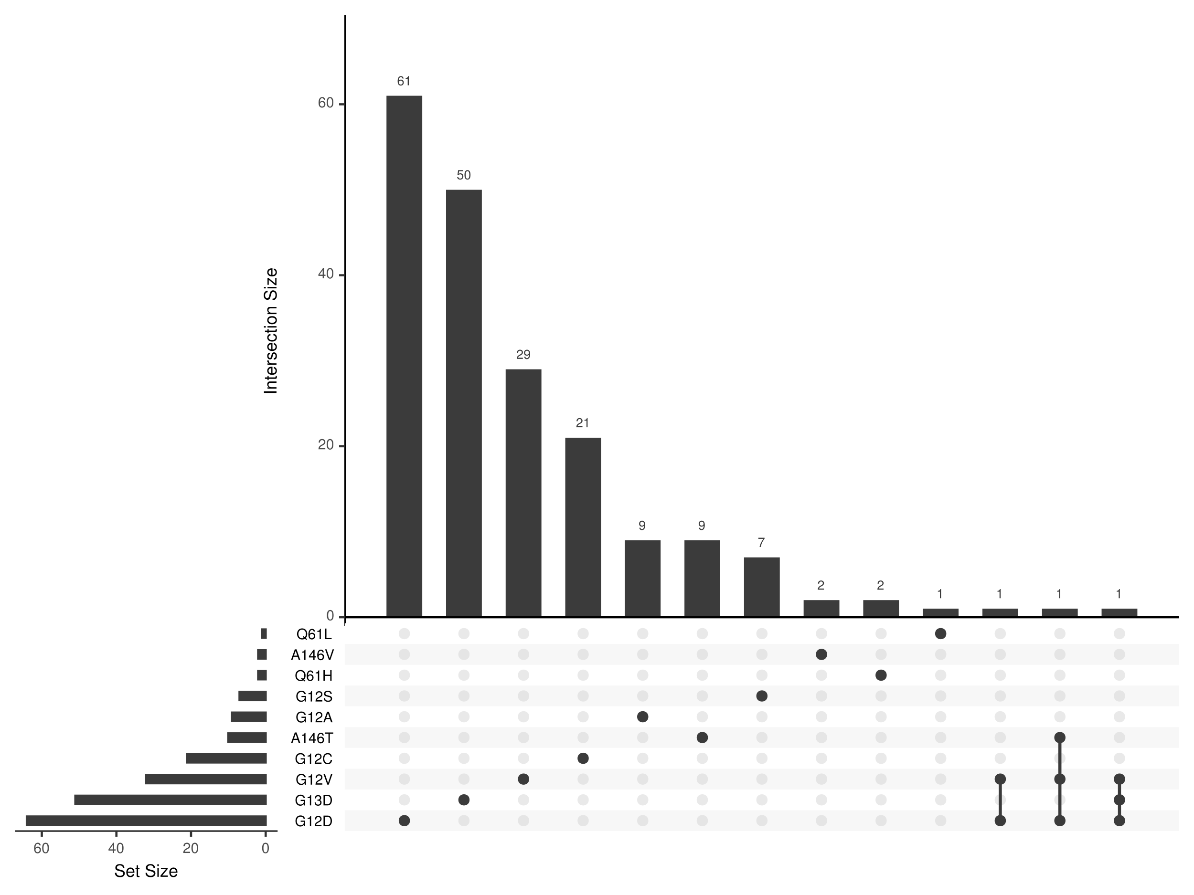
The alleles have distinct comutation interactions
COAD

Slide 12
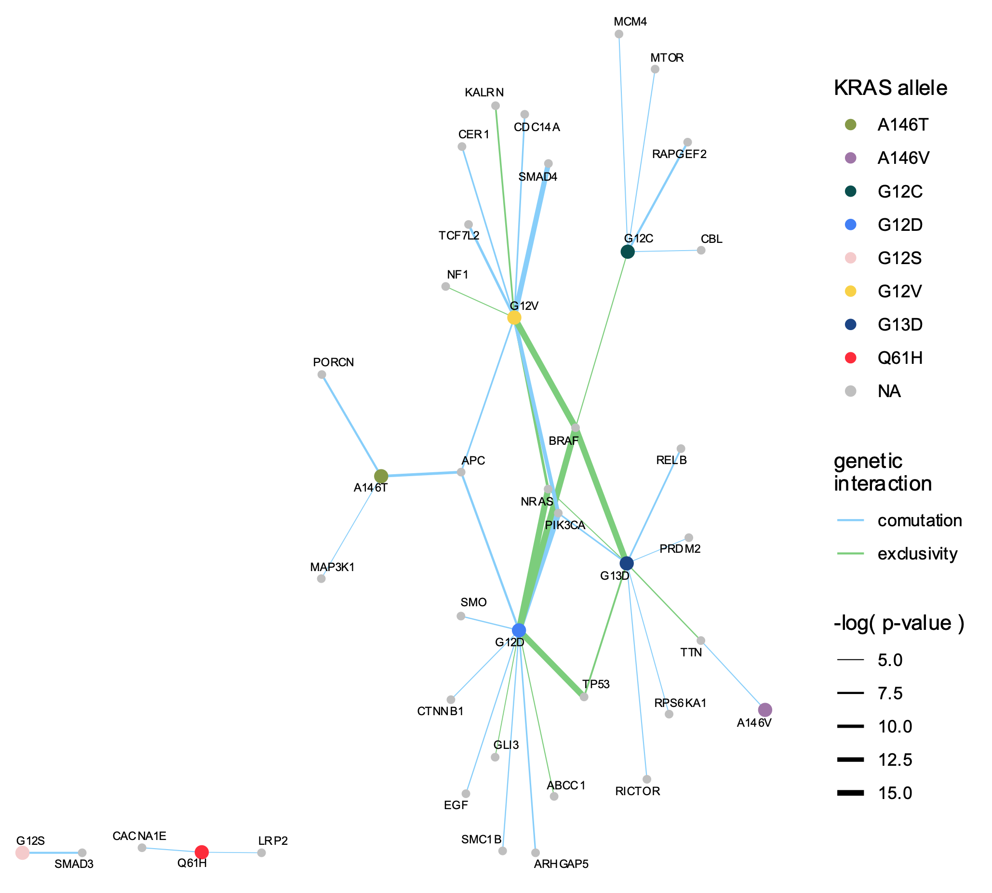
The alleles have distinct comutation interactions
COAD
Notes:
BRAF, NRAS mutually exclusive
PIK3CA comutation
APC comutation
A146T – PORCN, MAP3K1
G12V – SMAD4

Slide 13
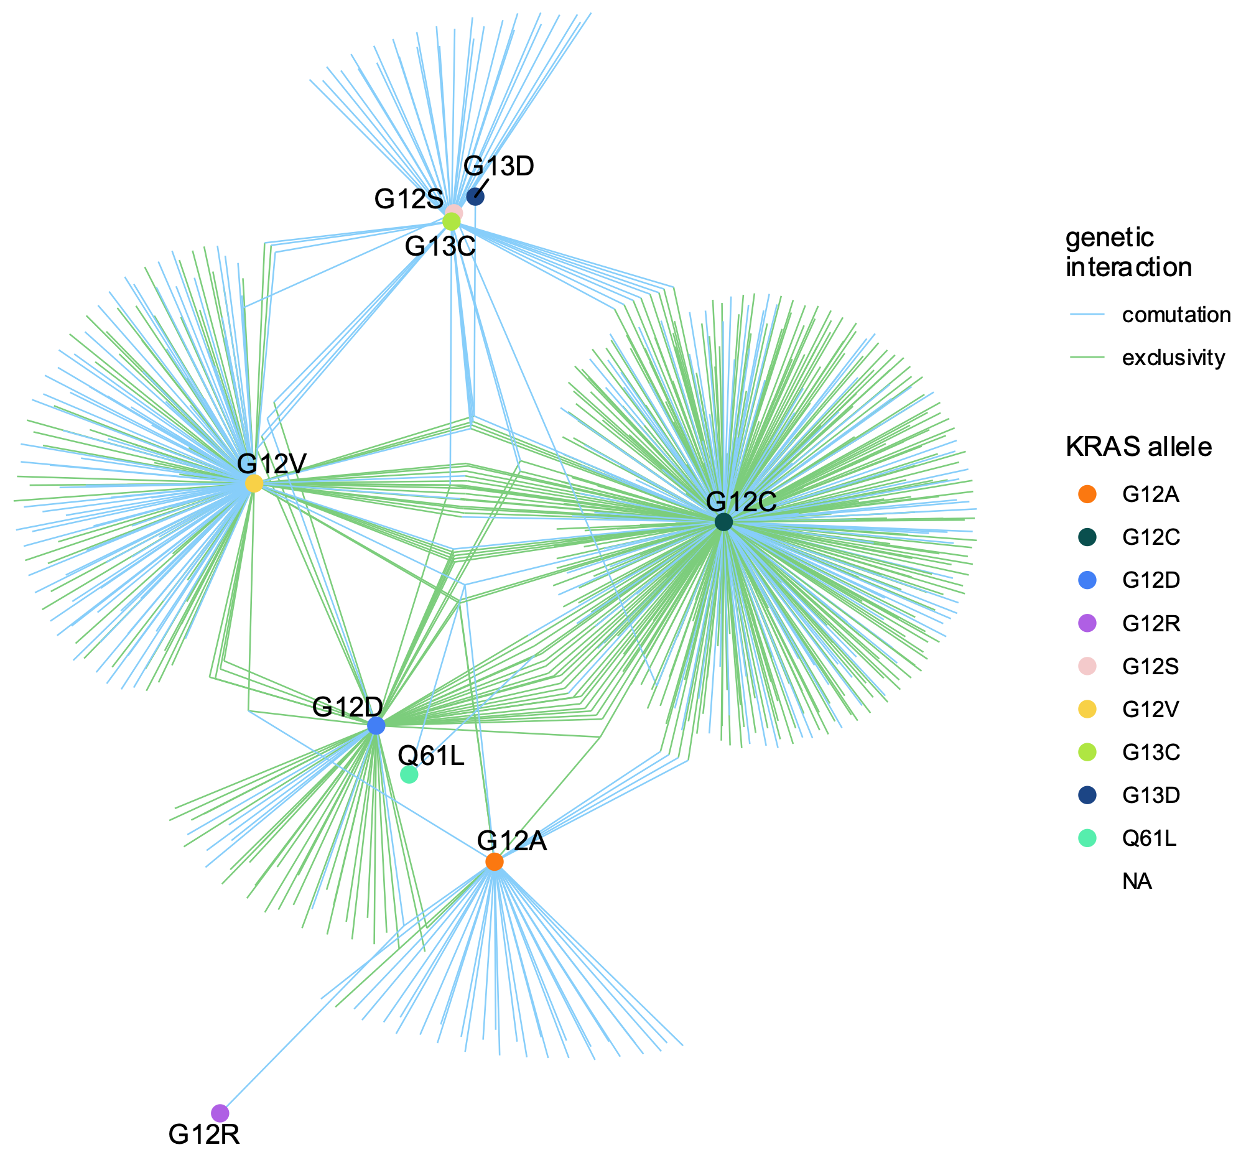
The KRAS alleles have distinct comutation interactions
LUAD
Notes:
Thicker lines
Larger dots for alleles
Only largest component

Slide 14
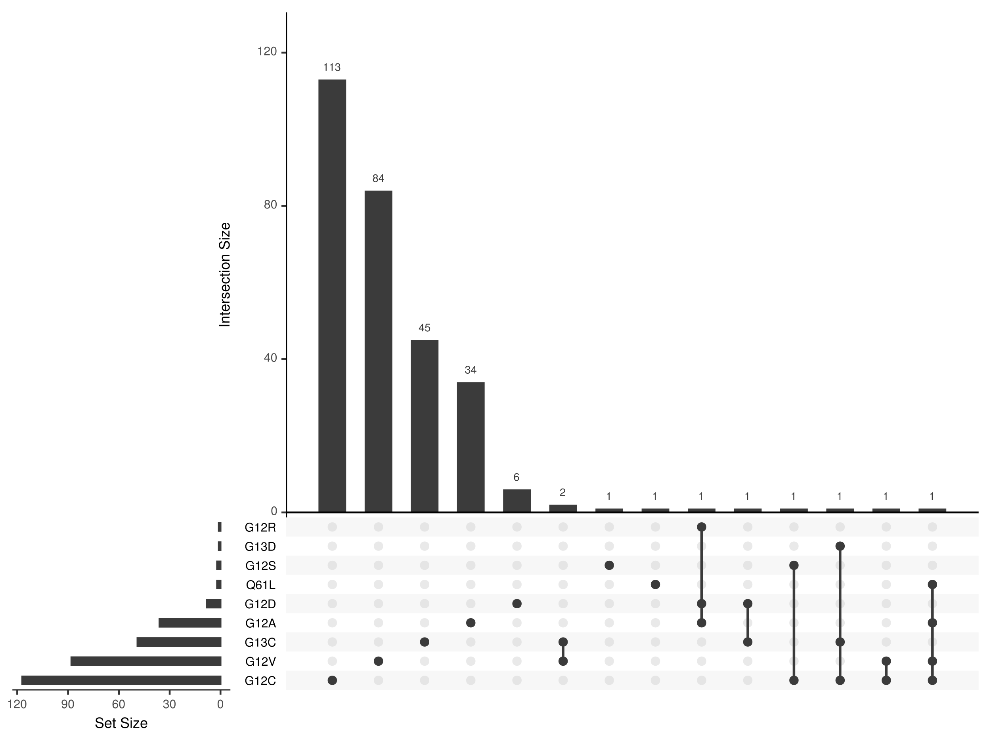
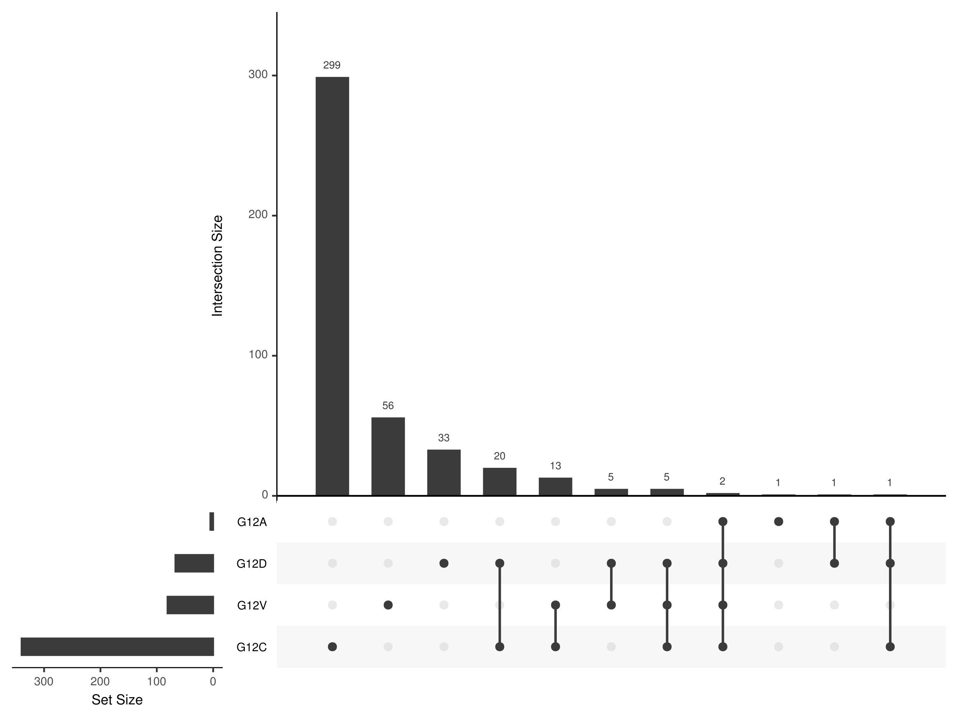
The alleles have distinct comutation interactions
LUAD
Comutation
Exclusive

Slide 15
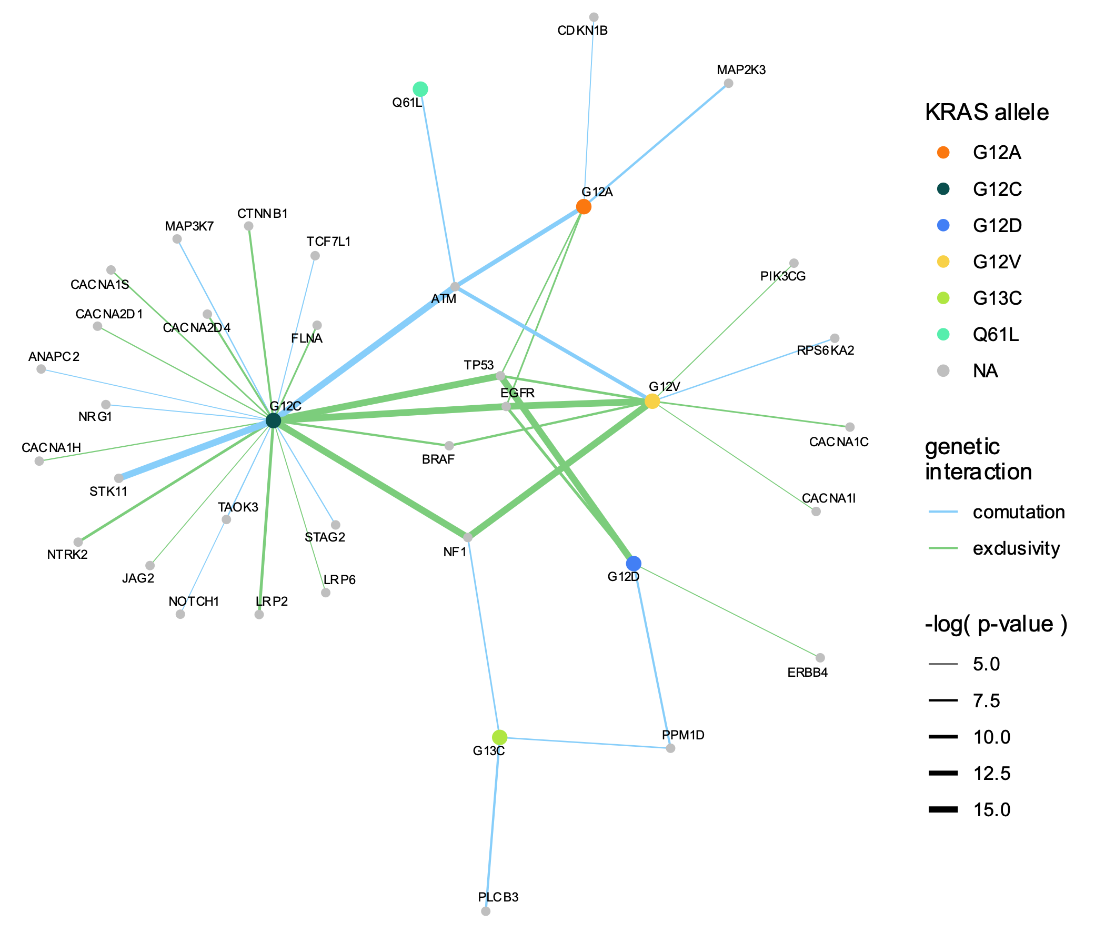
The KRAS alleles have distinct comutation interactions
LUAD
Notes:
(KEGG only)
G12C – STK11
TP53, EGFR, BRAF – strong mut ex.
ATM strong comutations
G12C, G12V mut. ex with NF1 – G13C weakly comutating

Slide 16
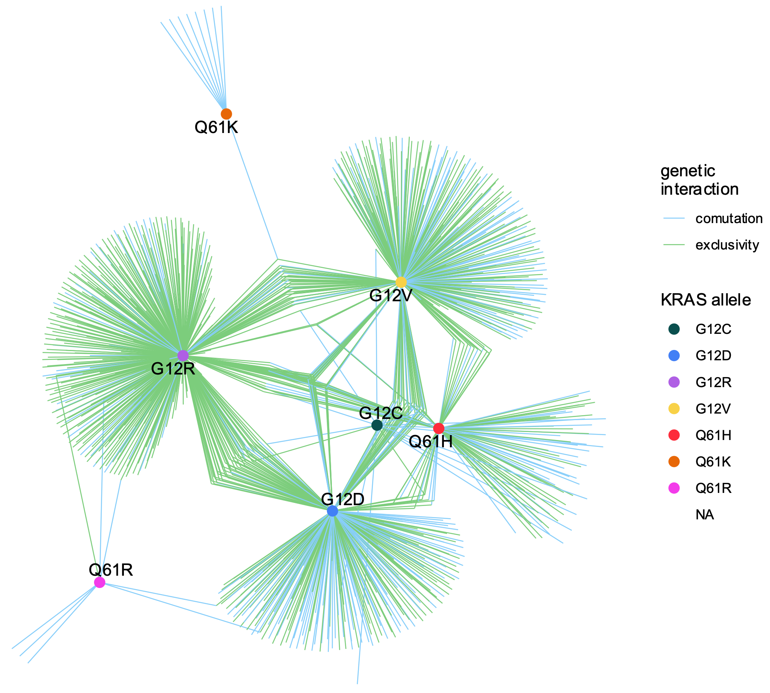
The KRAS alleles have distinct comutation interactions
PAAD
Notes:
Thicker lines
Larger dots for alleles
Only largest component

Slide 17
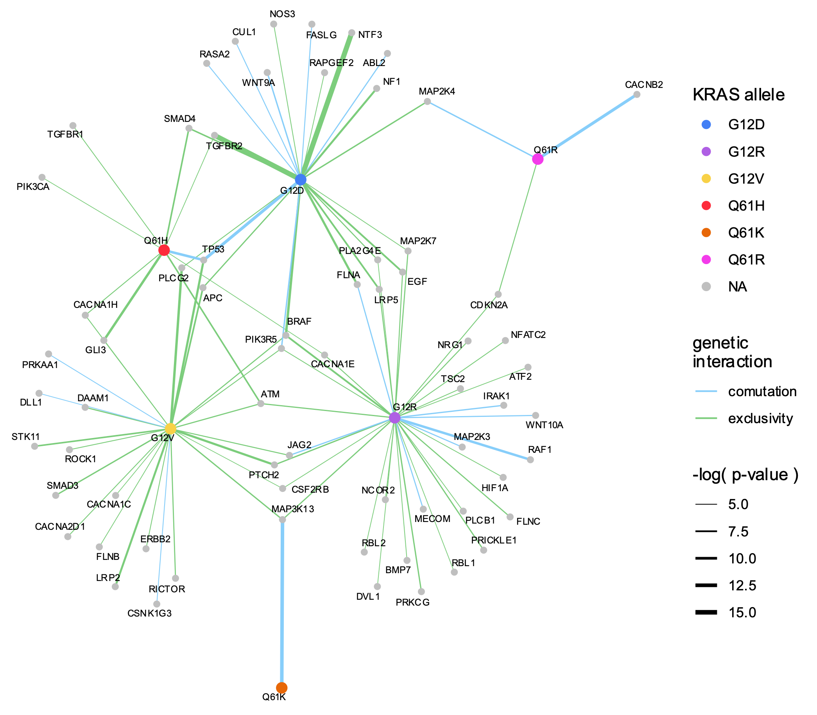
The KRAS alleles have distinct comutation interactions
PAAD
Notes:
(KEGG only)
BRAF mut ex.
Q61H and G12D – comut with TP53, but G12V mut. ex.
G12V mut ex with JAG2 and comut with G12R
MAP3K13 mut ex. wih G12V and G12R, comut with Q61R
PIK3R5 – mut ex with G12V and G12R, comut with G12D

Slide 18
Can we identify synthetic lethal interactions
with the KRAS alleles?

Slide 19
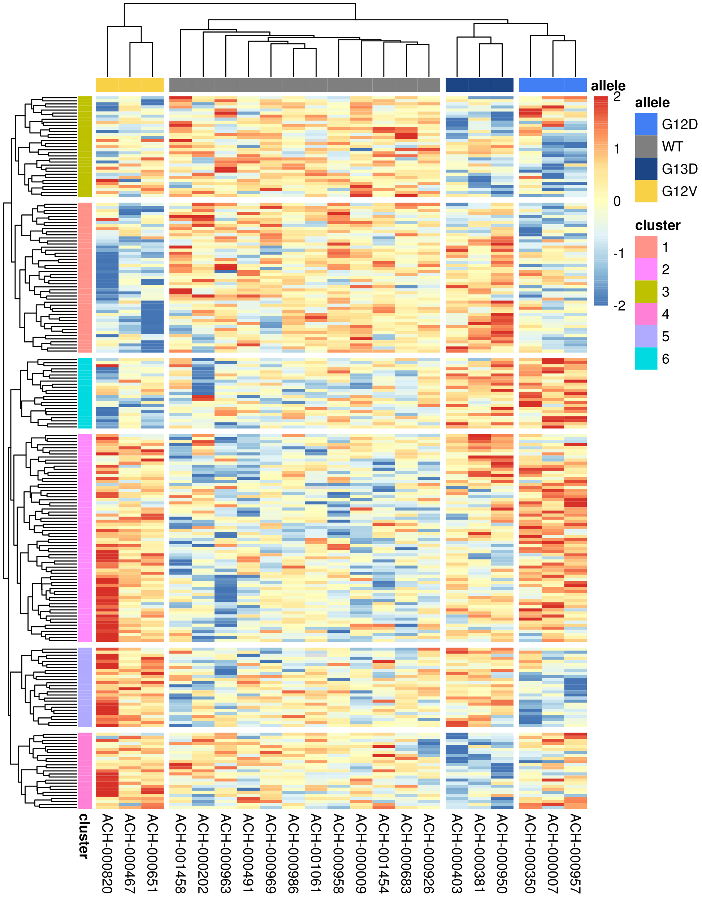
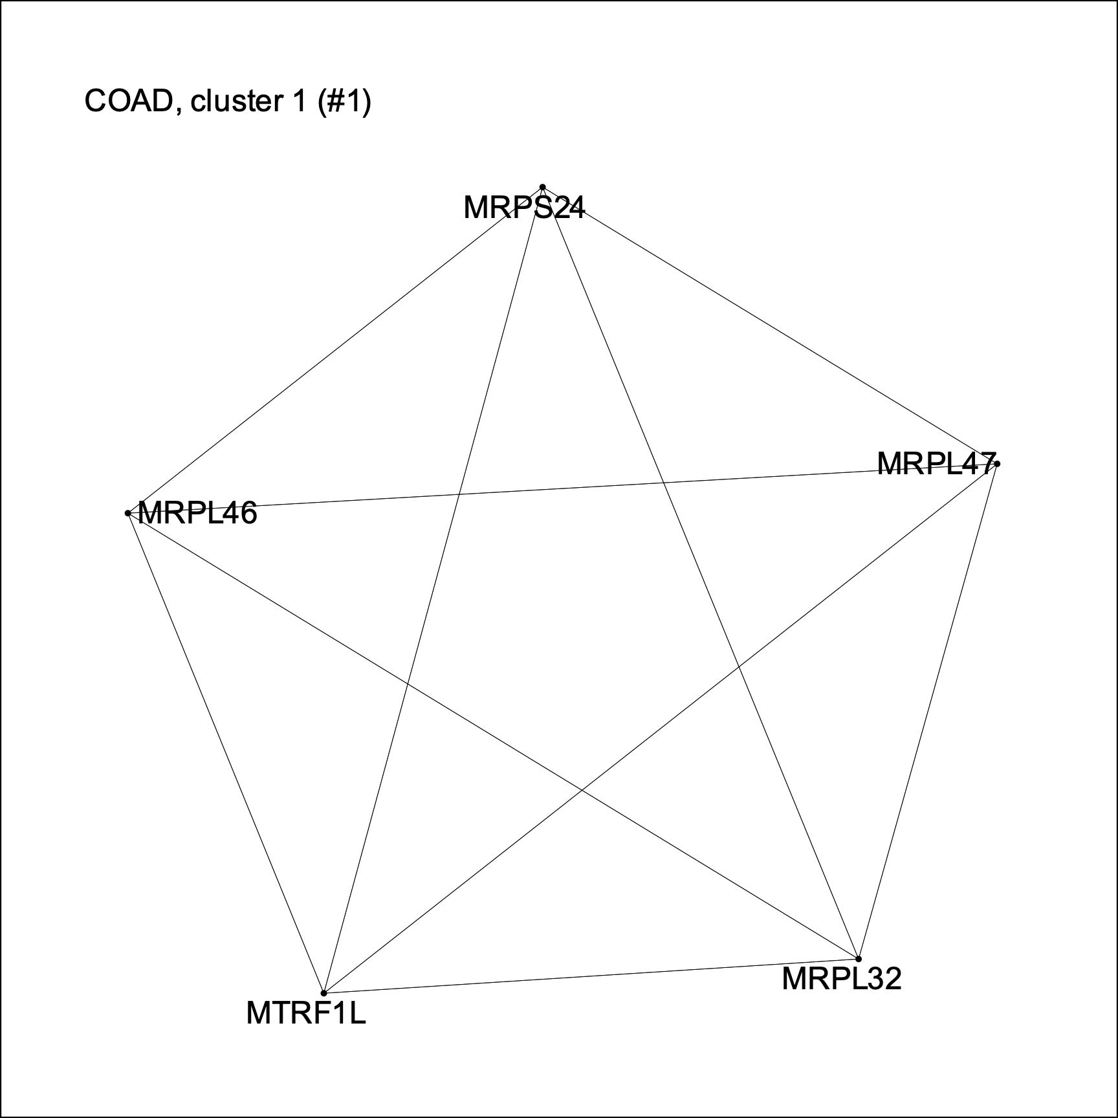
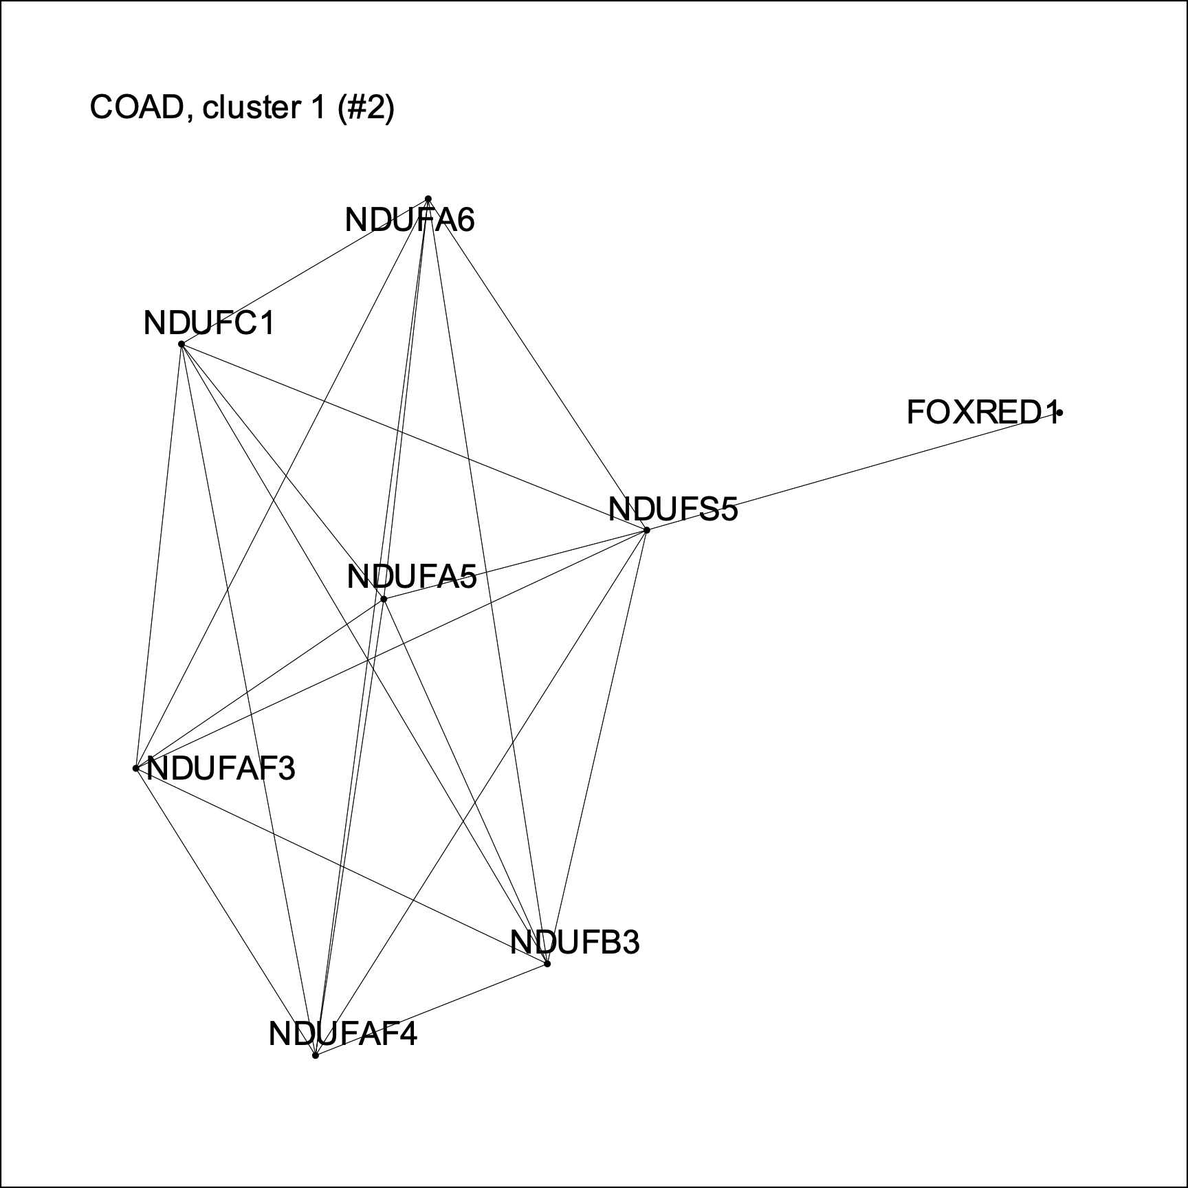
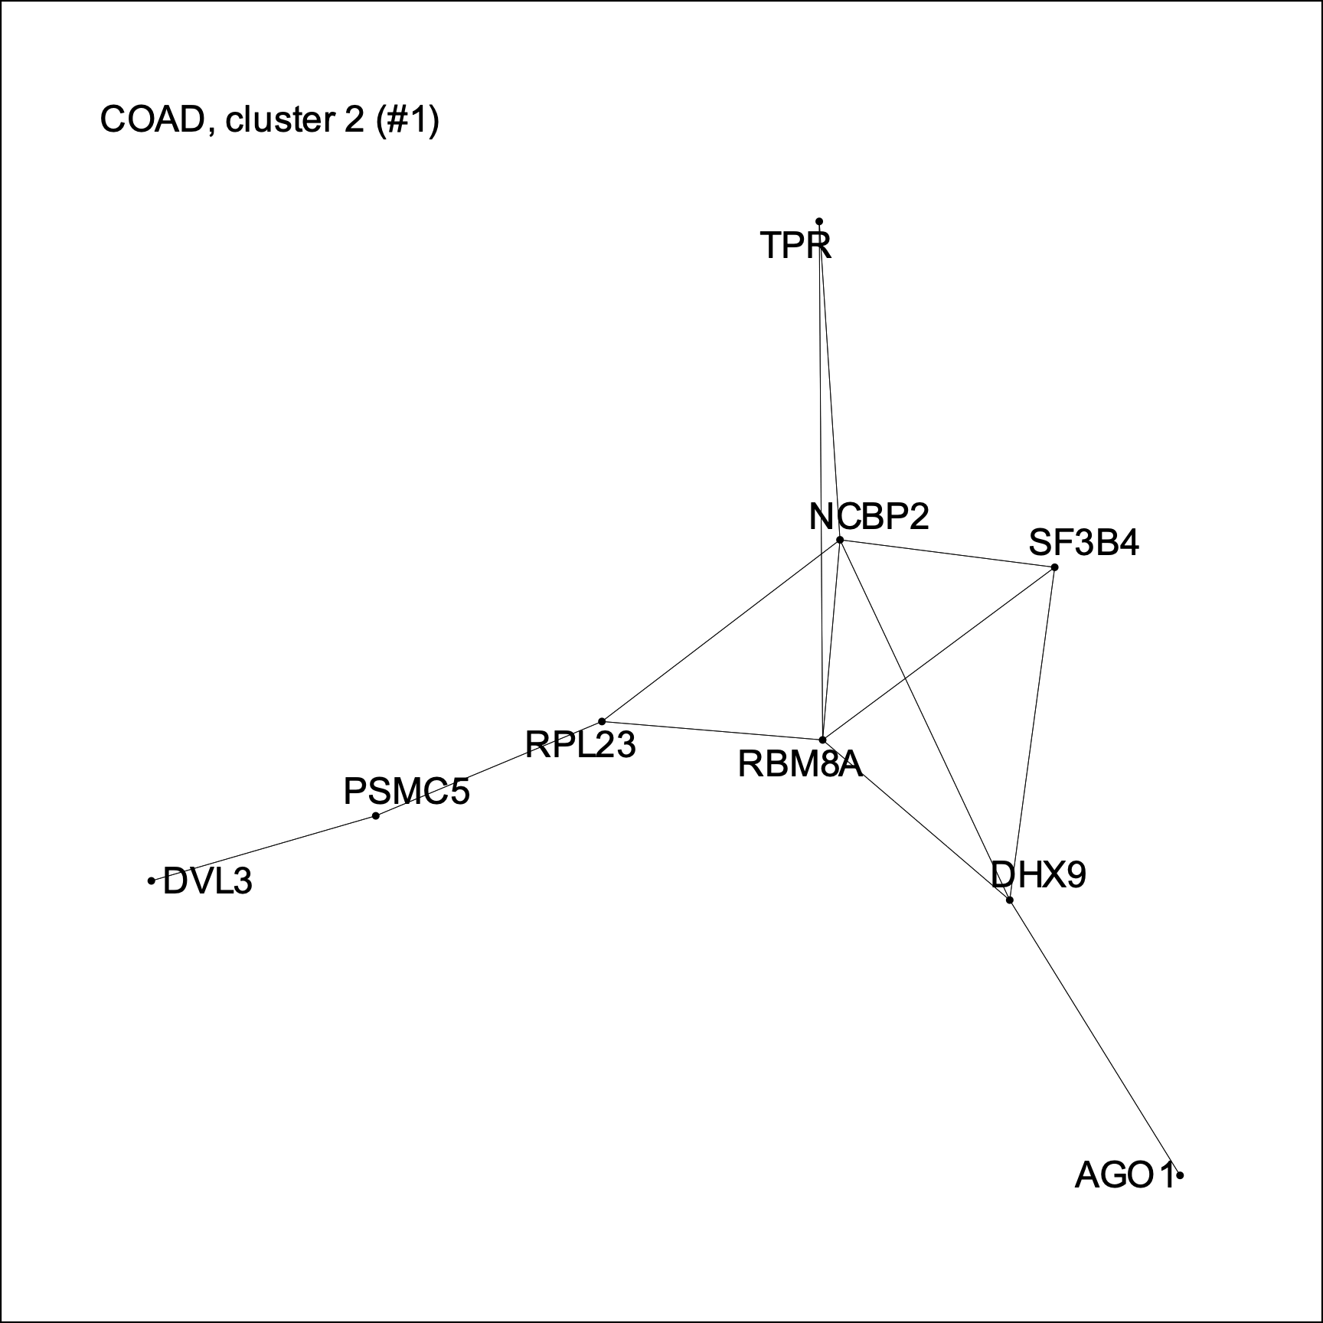
The KRAS alleles have specific synthetic lethal interactions
COAD
COAD
Notes:
1.1 – ribosomal proteins
1.2 – NADH dehydrogenase complex
2 – RNA processing
TPR: part of nuclear pore complex involved in transport of Erk
DVL3: dischevled homolog; part of Wnt signaling

Slide 20
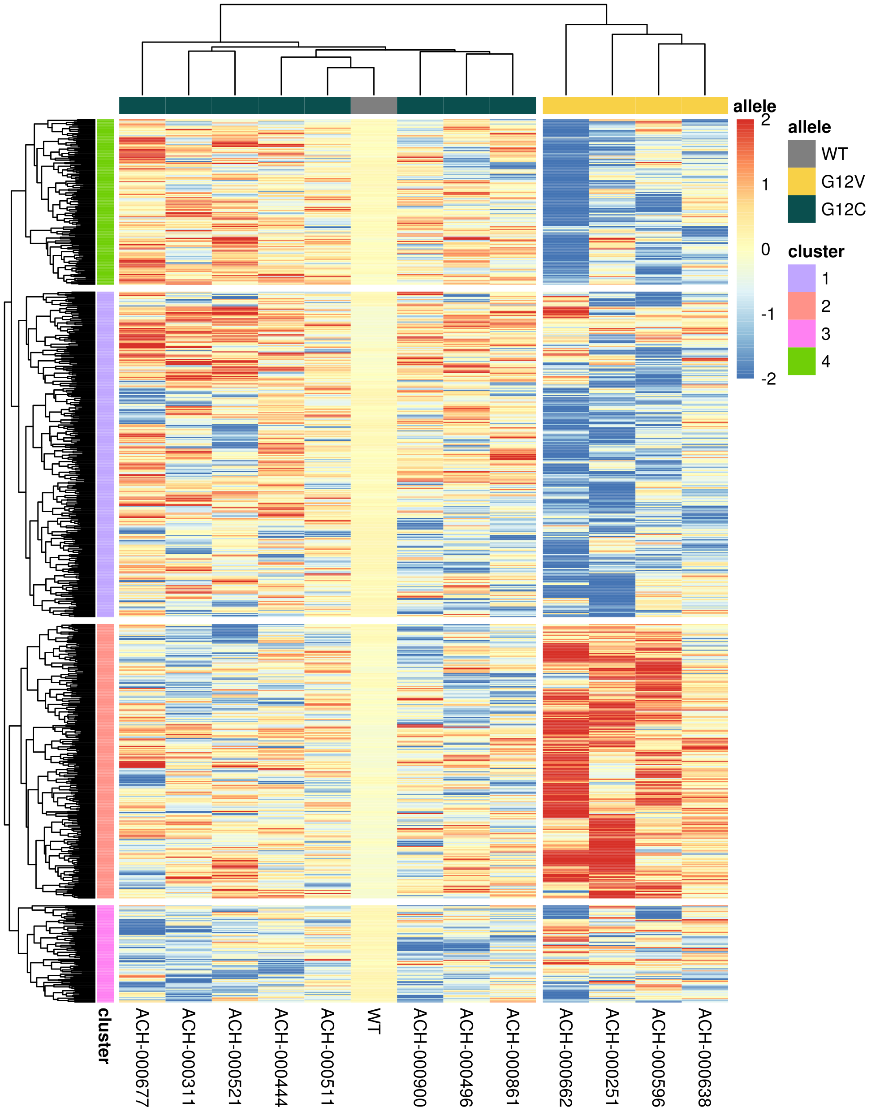
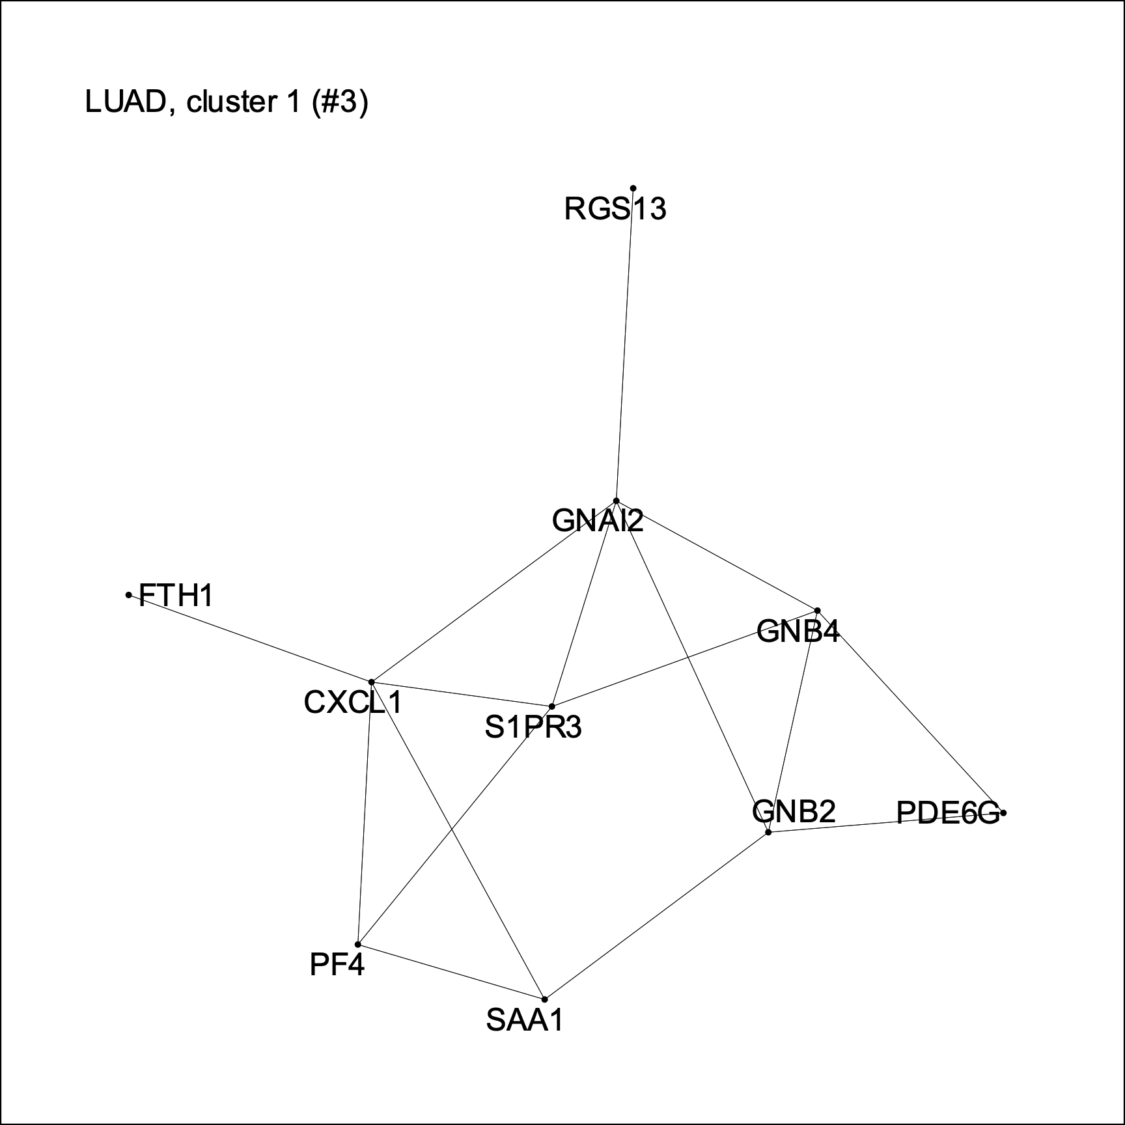
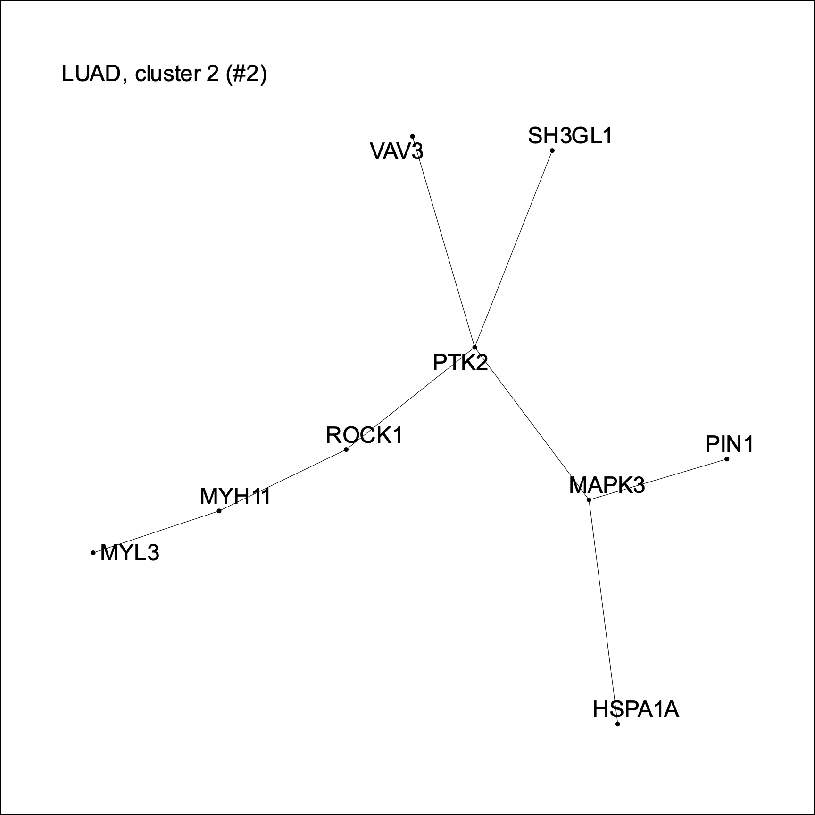
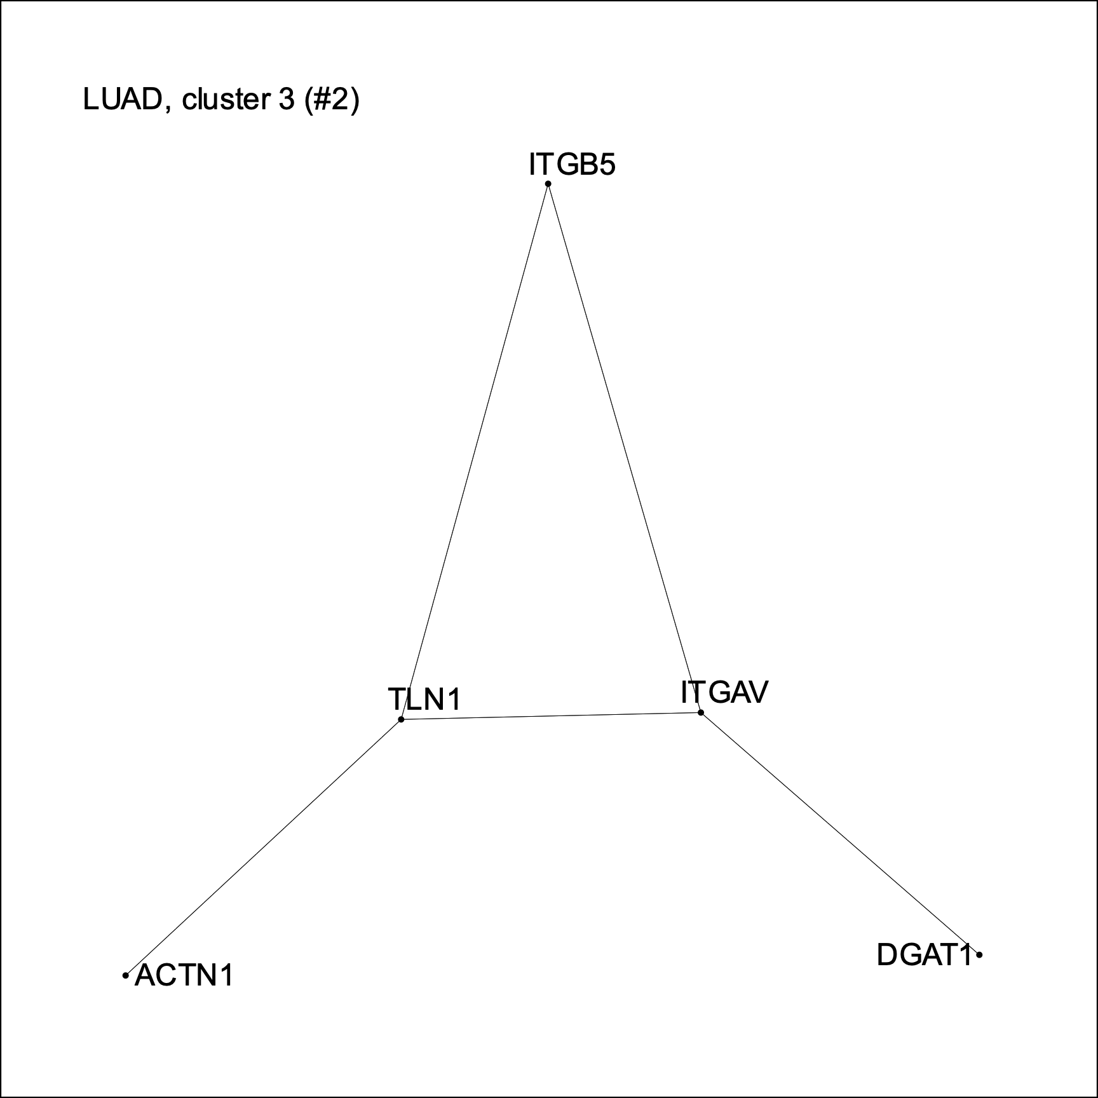
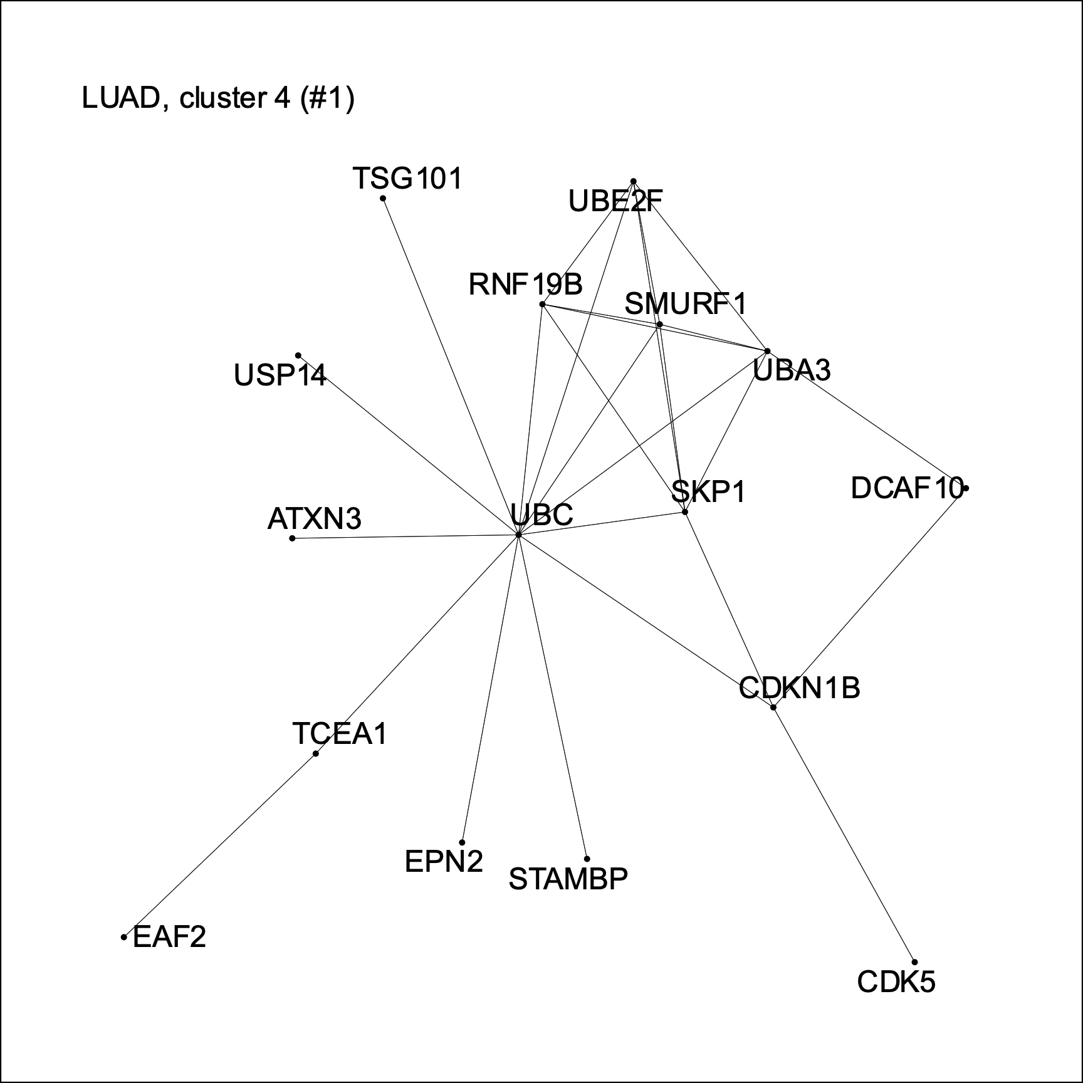
The KRAS alleles have specific synthetic lethal interactions
LUAD
LUAD
Notes:
1 – some parts of GPCR signaling
2 – focal adhesion machinery
3 – integrins
4. – UBC (ubiquitin), SMURF1 (E3 ligase), SKP1 (part of ubiquitin ligase complex)

Slide 21
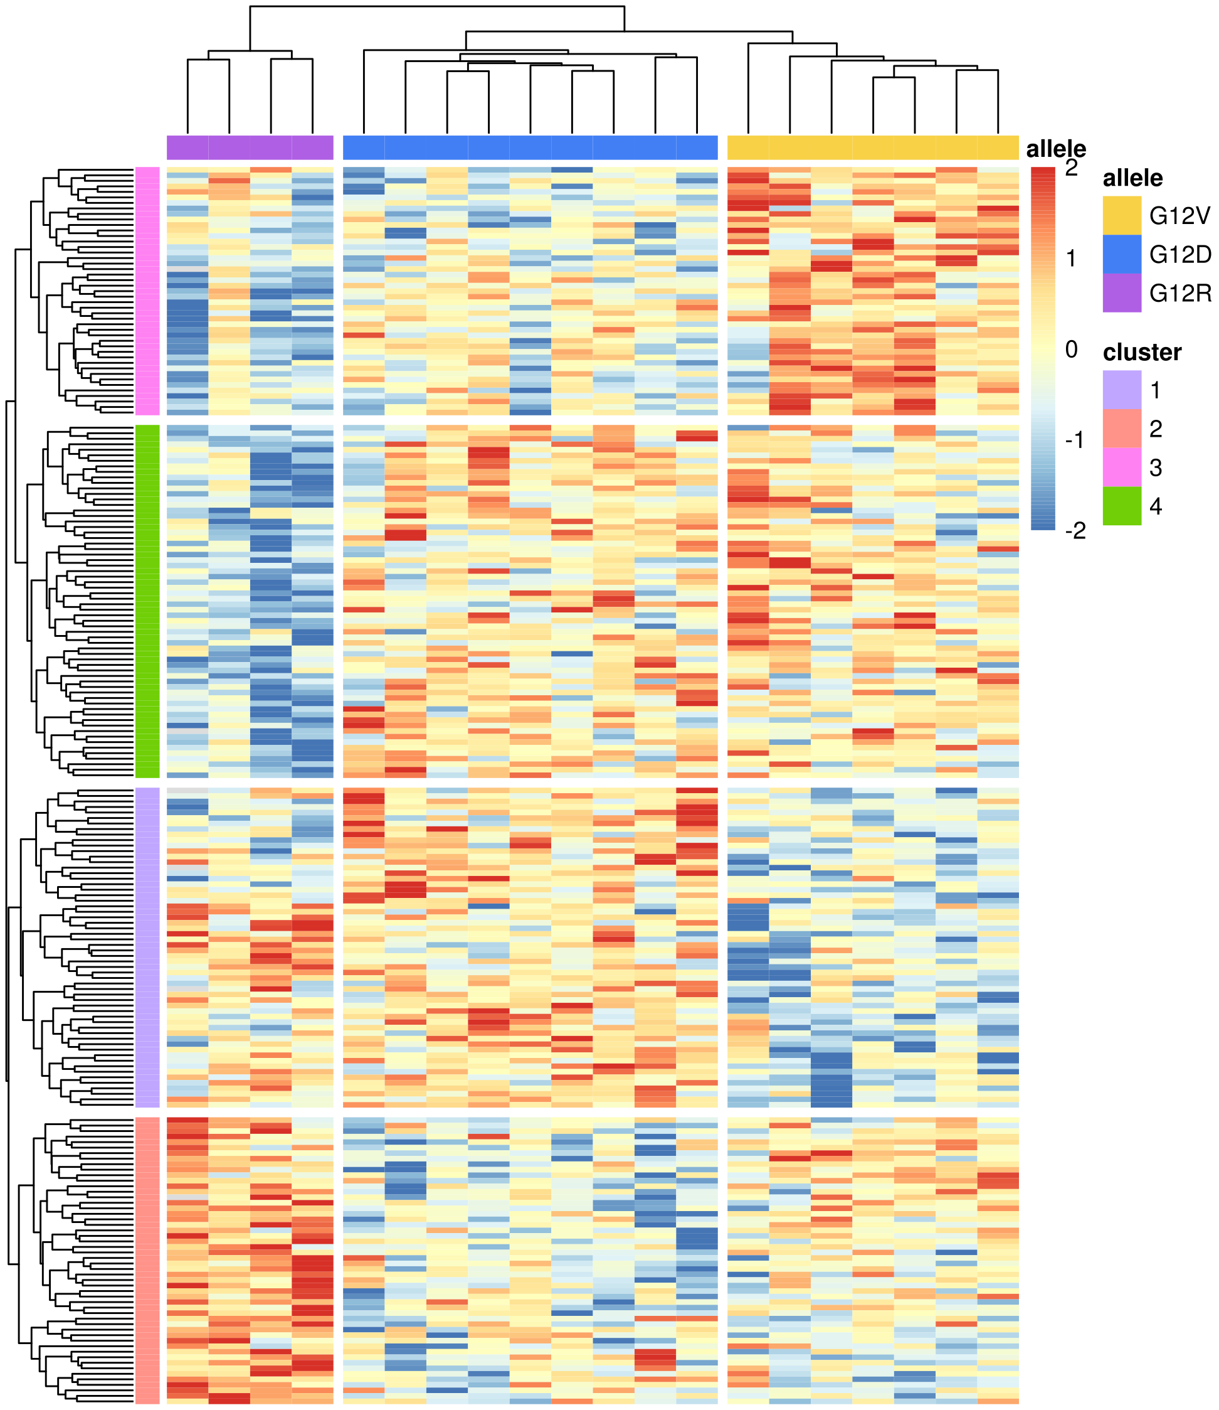
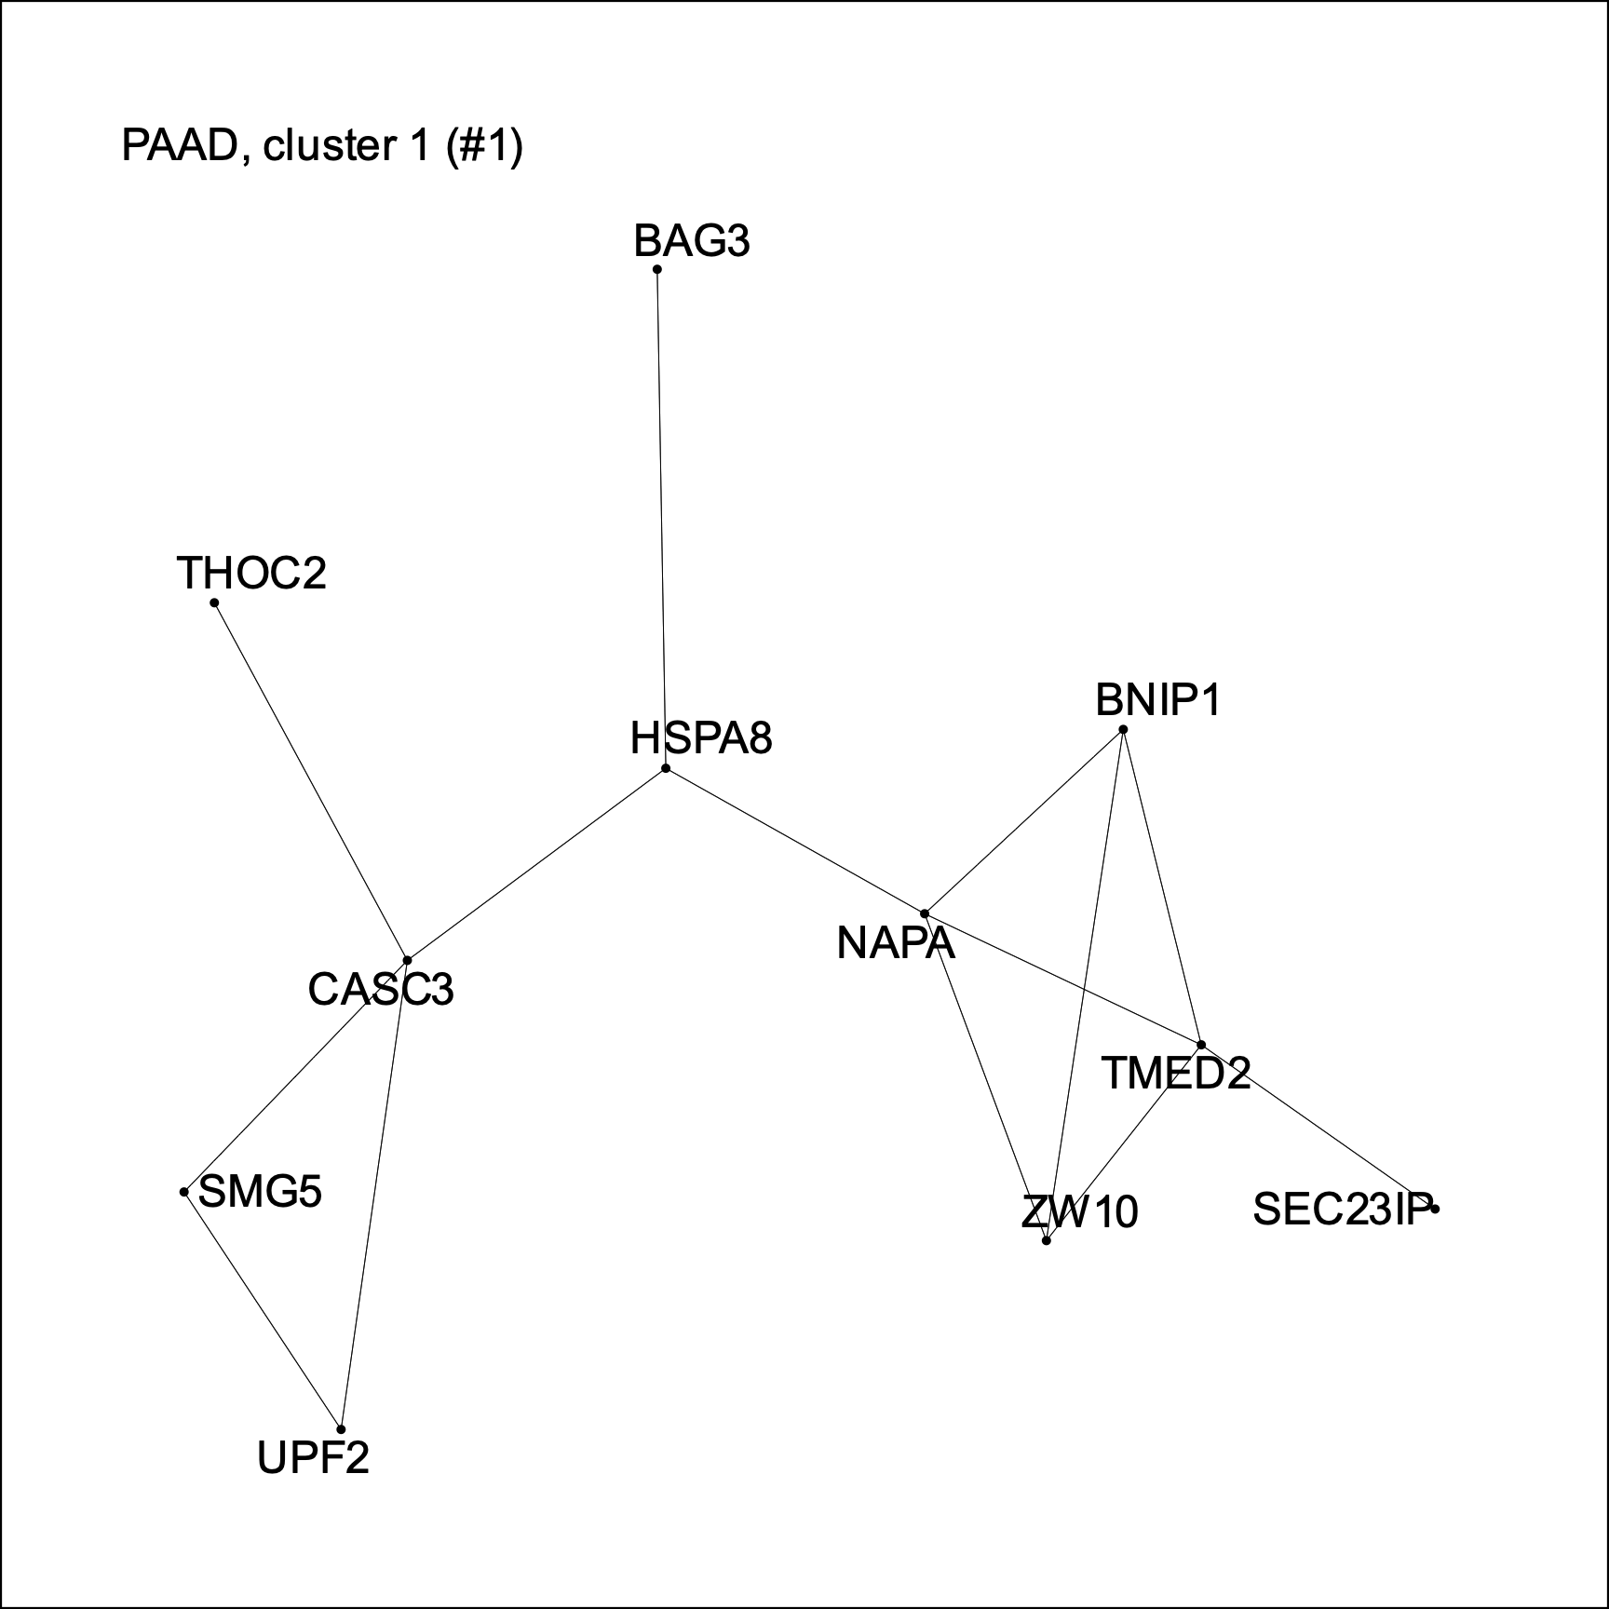
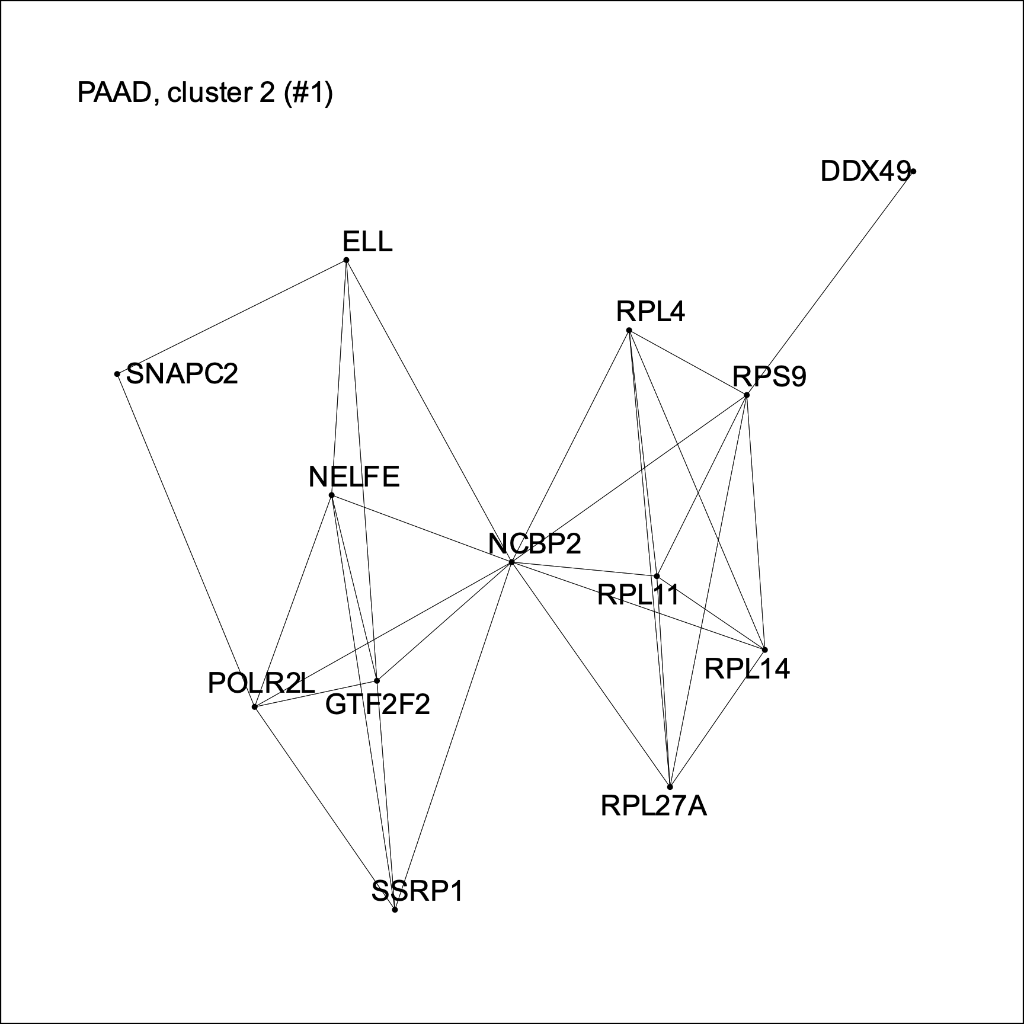
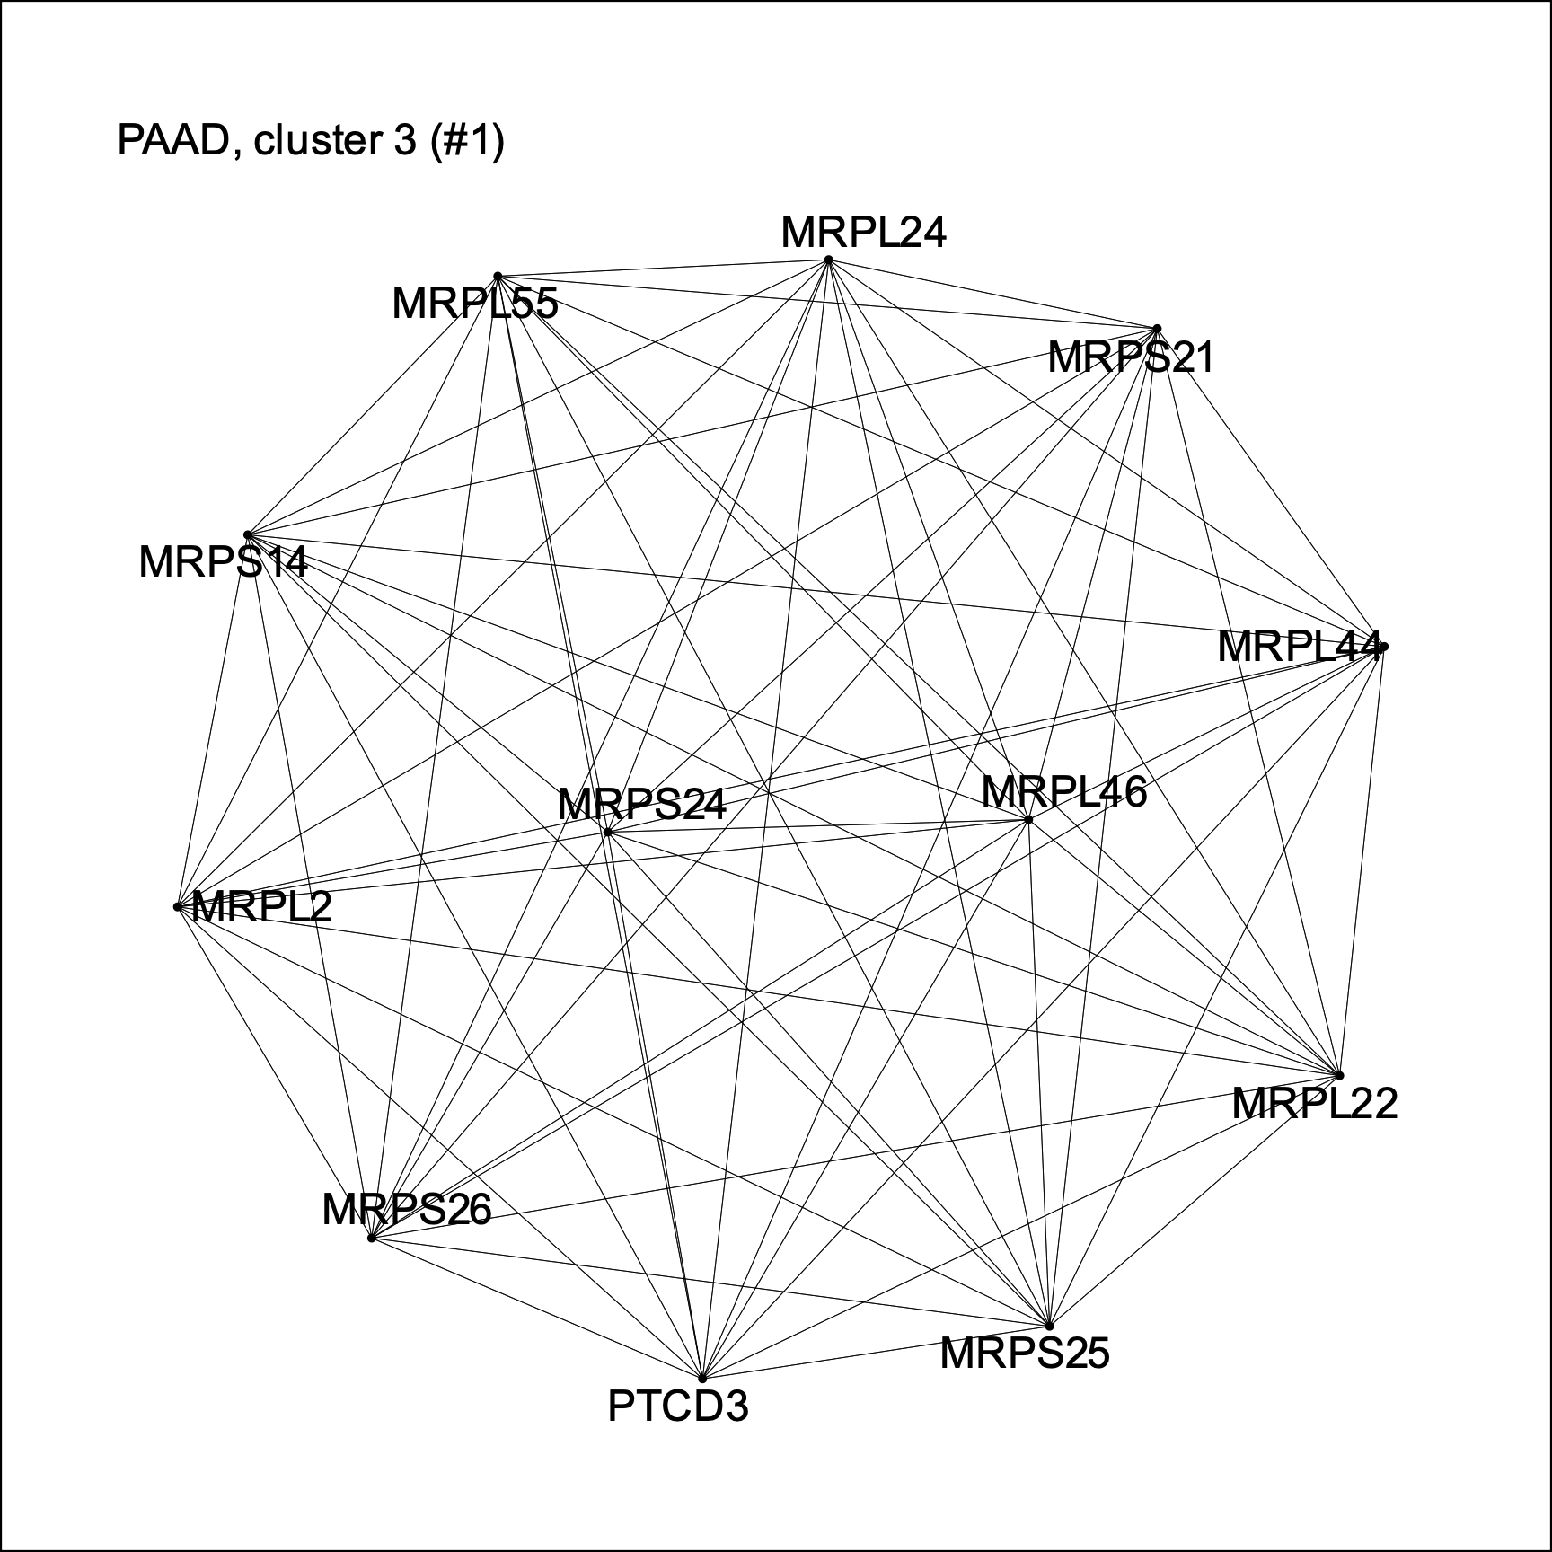
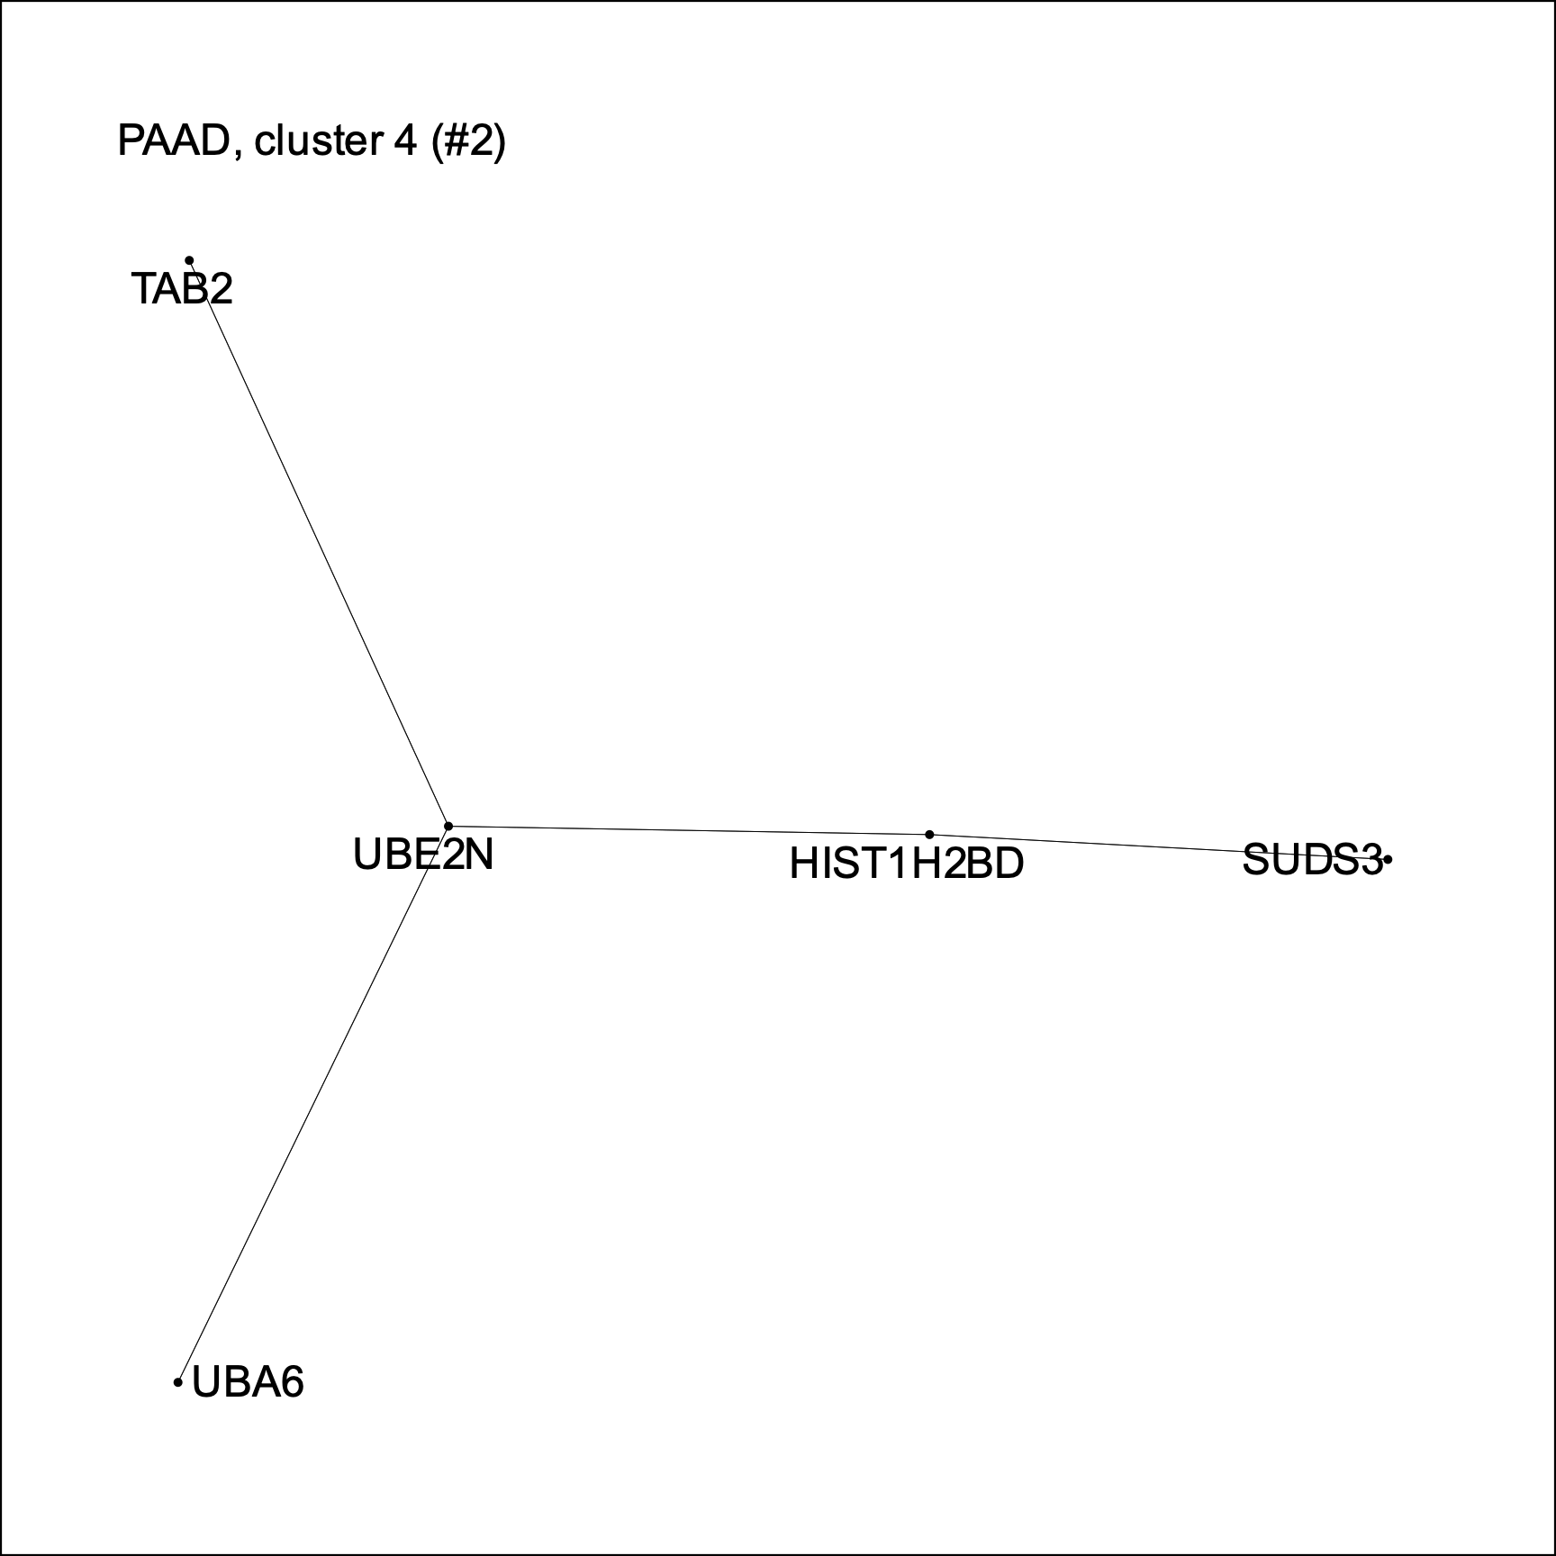
The KRAS alleles have specific synthetic lethal interactions
PAAD
PAAD
Notes:
1 – chaperones and mRNA processing machinery for stress response
2 – mRNA translocation and processing
3 – ribosomal proteins
4 – linking between MAPK pathway and ubiquitination

Slide 22
Conclusions
Mutational processes, alone, cannot explain the distribution of KRAS alleles.
The alleles have complex and distinct interactions with other genes.
These genetic interactions can potentially be exploited for therapeutic purposes.

Slide 23
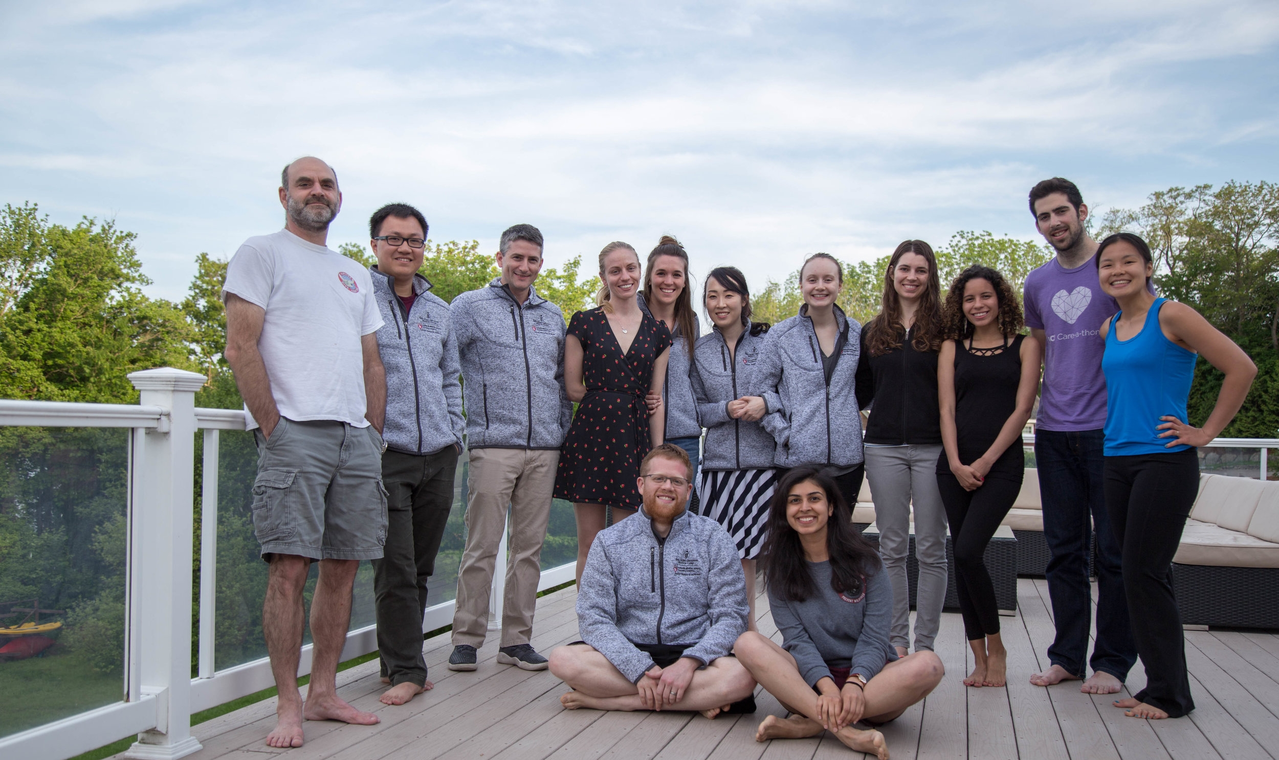

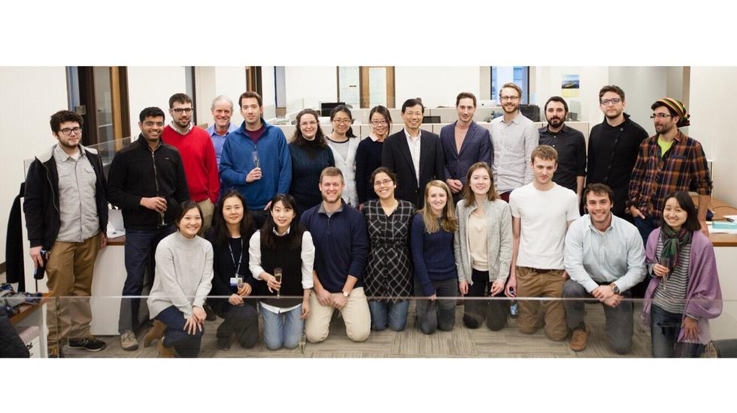
Acknowledgements
Haigis Lab
Park Lab
SpecifiCancer

Slide 24
Questions?

